Slide 1
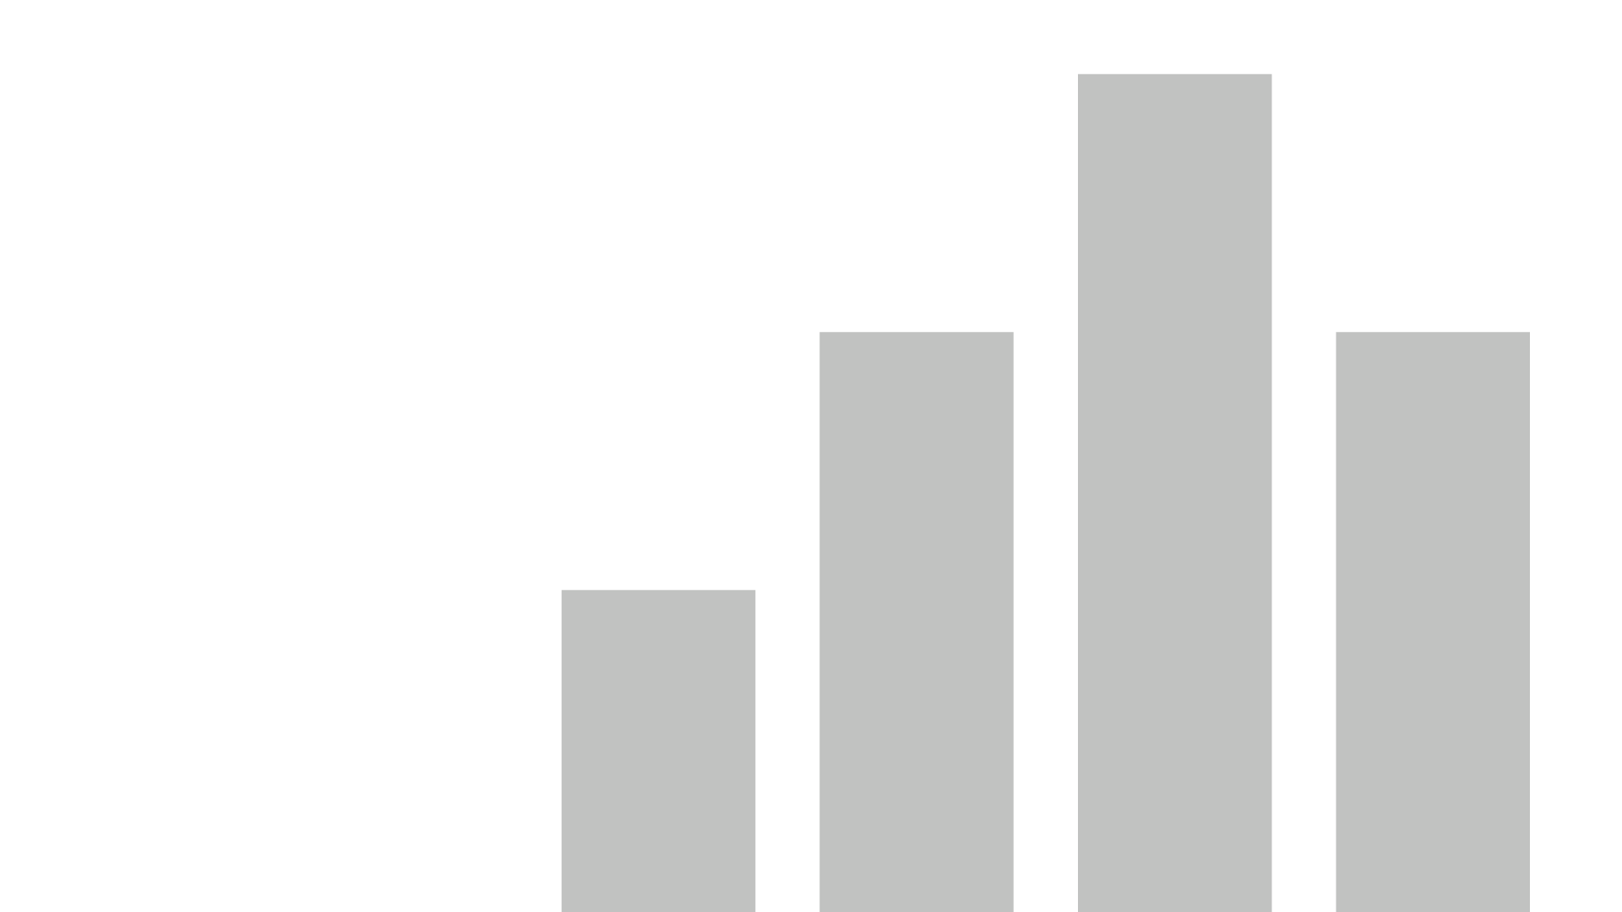


gold prices
View in Power BI
Last data refresh:
9/25/2025 9:27:06 AM UTC
Downloaded at:
9/25/2025 10:31:00 AM UTC

Slide 2
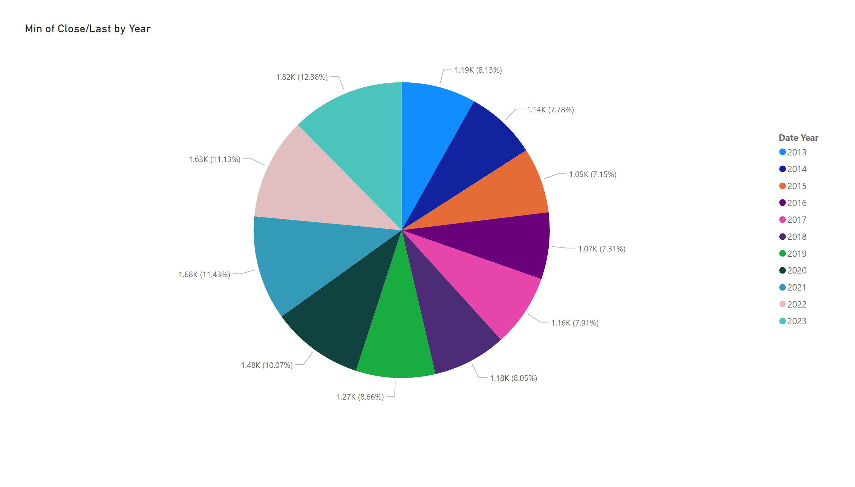
Page 1
Notes:
pieChart
No alt text provided

Slide 3
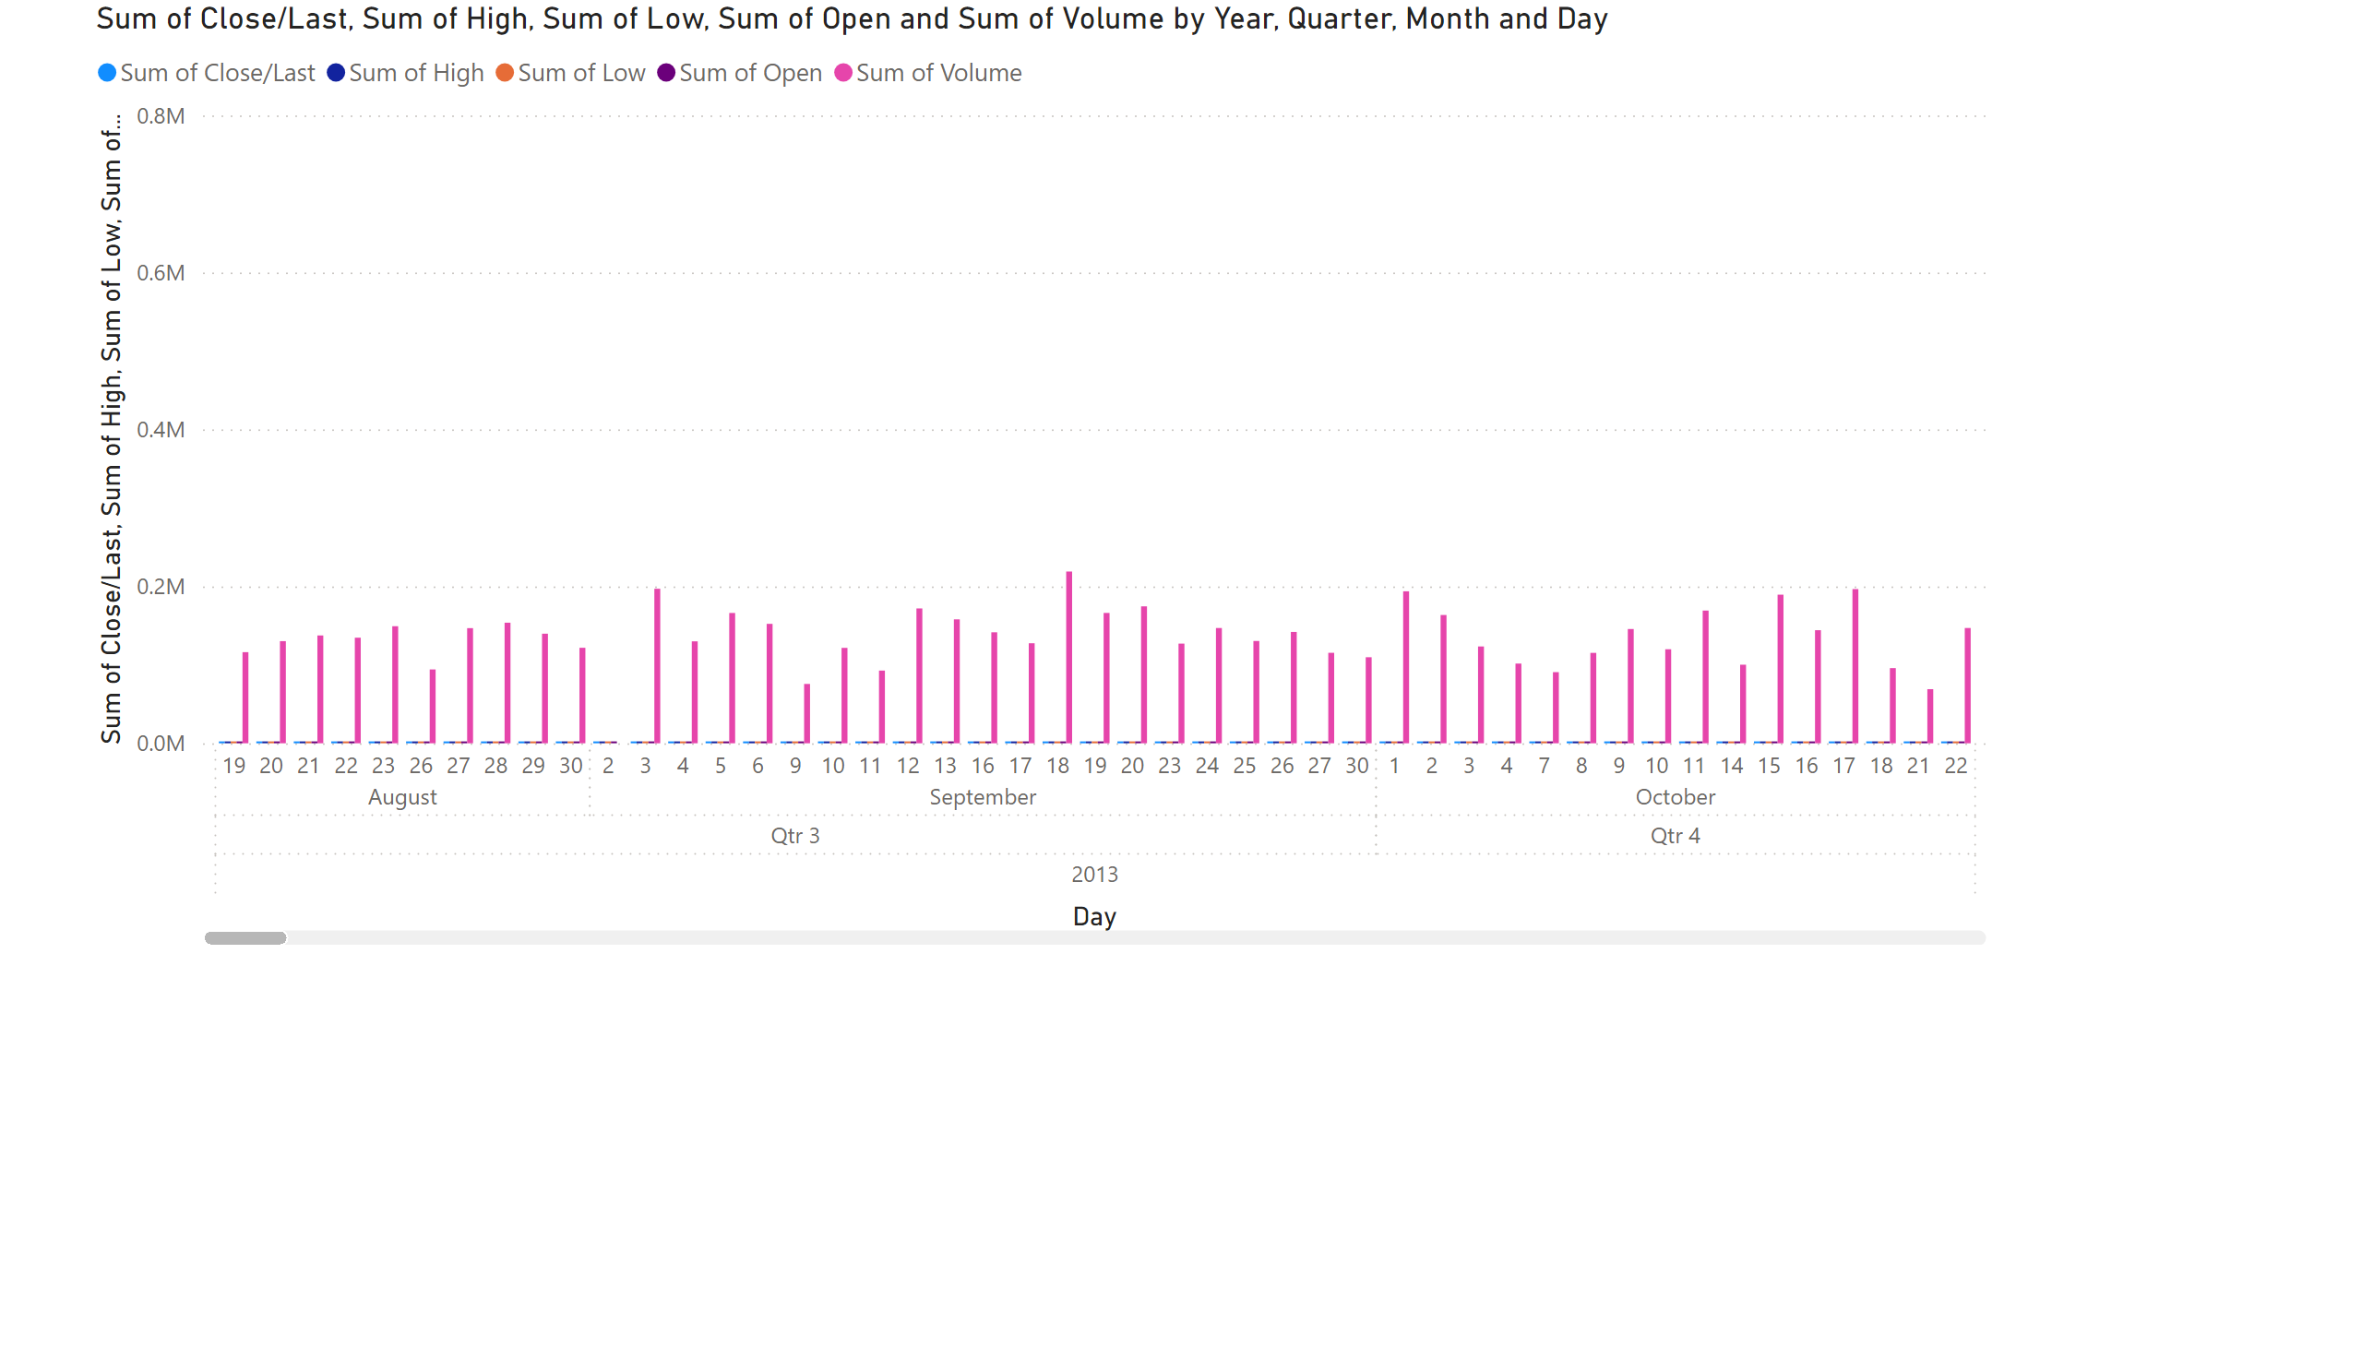
Page 2
Notes:
clusteredColumnChart
No alt text provided

